Slide 1



Smoke detector
Subject - MAR

Slide 2


Introduction List of components Connection diagram Code Features References

Slide 3
Introduction
In this project, we have designed Arduino Smoke Level Detector using MQ-135 Sensor for measuring the level of smoke in the environment.
Smoke Detectors are very useful in detecting smoke or fire in buildings, and so are the important safety parameters.
Smoke Detector Circuit which not only senses the smoke in the air but also reads and displays the level of Smoke in the Air.

Slide 4
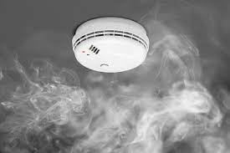
List of components
1 Arduino Board
2 LCD Display
3 Potentiometer
4 MQ-135 Sensor
5 Buzzer
6 LED
7 Connecting Wires
8 Breadboard

Slide 5
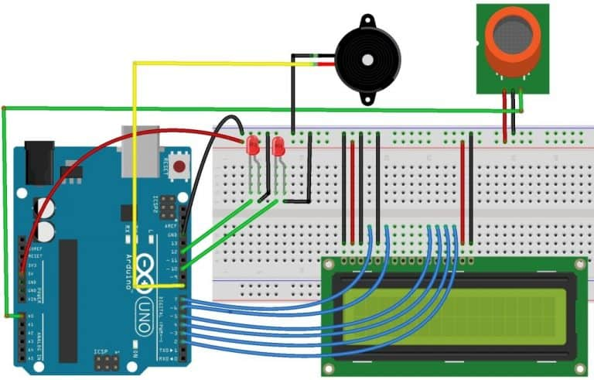
Connection diagram

Slide 6

Code
#include <LiquidCrystal.h>
LiquidCrystal lcd(7, 6, 5, 4, 3, 2);
int redLed = 10;
int greenLed = 12;
int buzzer = 8;
int smokeA0 = A0;
// Your threshold value
int sensorThres = 100;
void setup() {
pinMode(redLed, OUTPUT);
pinMode(buzzer, OUTPUT);
pinMode(smokeA0, INPUT);
Serial.begin(9600);
lcd.begin(16,2);
}

Slide 7
Code
void loop() {
int analogSensor = analogRead(smokeA0);
Serial.print("Pin A0: ");
Serial.println(analogSensor);
lcd.print("Smoke Level:");
lcd.print(analogSensor-50);
// Checks if it has reached the threshold value
if (analogSensor-50 > sensorThres)
{
digitalWrite(redLed, HIGH);
lcd.setCursor(0, 2);
lcd.print("Alert....!!!");
digitalWrite(12, LOW);
tone(buzzer, 1000, 200);
}

Slide 8
Code
else
{
digitalWrite(redLed, LOW);
digitalWrite(12, HIGH);
lcd.setCursor(0, 2);
lcd.print(".....Normal.....");
noTone(buzzer);
}
delay(500);
lcd.clear();
}

Slide 9

Features
Fast response and high sensitive
Wide detecting scope
Easy to use and affordable

Slide 10
Reference
Arduino Smoke Level Detector using MQ-135 Sensor with Alarm (how2el
ectronics.com)
Youtube Video : https://youtu.be/EgBVb32vopc

Slide 11

THANK YOU
…

